Slide 1

From GitLab to Power Platform:
Cloud - Native ALM with PAC CLI and Google Cloud
NEW ZEALAND
BUSINESS
APPLICATIONS
SUMMIT 2025
Pavan Mani Deep Yaragani
Dynamics CRM Solution Architect | NeoSoft, Dubai

Slide 2
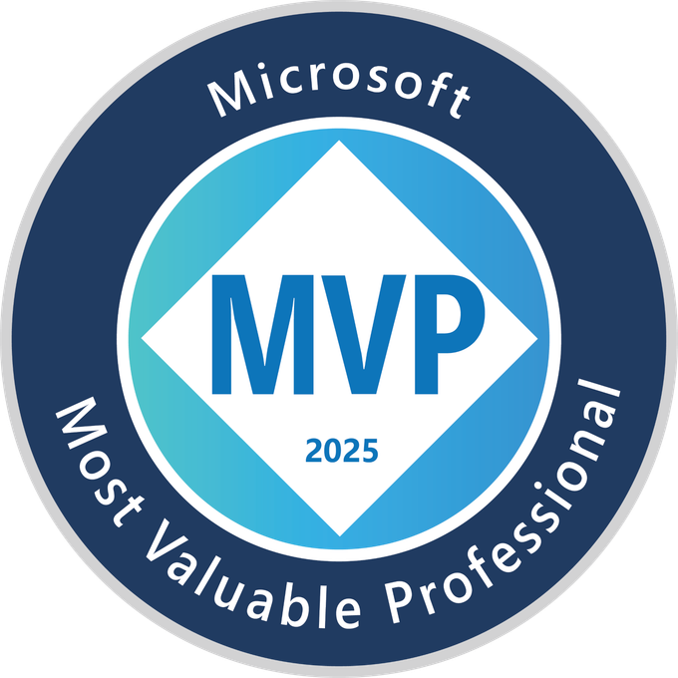
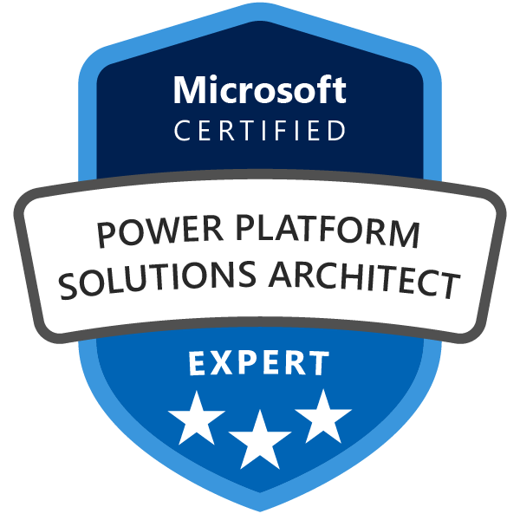
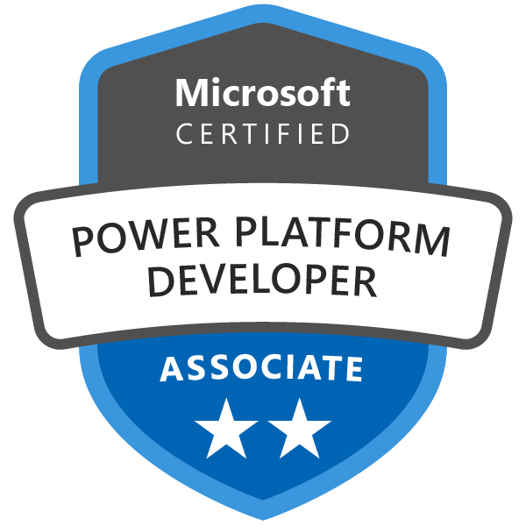
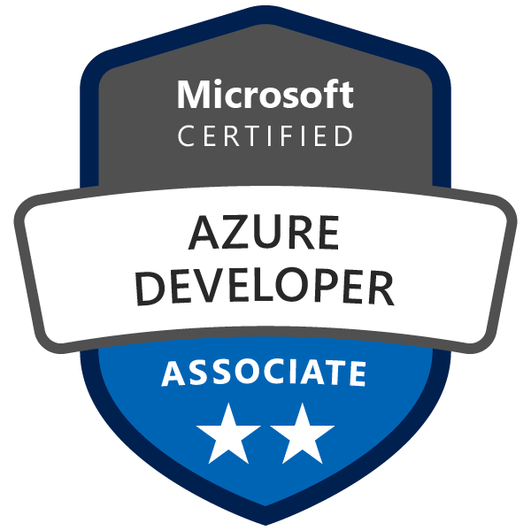
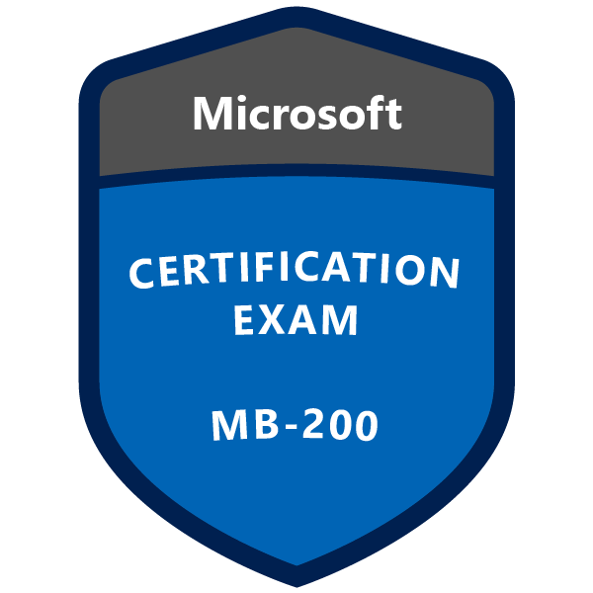
About Me
Microsoft MVP (2024, 2025) in Power Apps
Currently at NeoSoft, Dubai, United Arab Emirates
Focus: Model Driven Apps, Deployments CI/CD Automation, Cloud Architecture
#NZBAS25

Slide 3
Session Agenda
Before we dive into technical details, let me set some context.
Most organizations who are using Microsoft Ecosystem use Azure DevOps to handle their ALM
GitLab for its powerful code collaboration features, but we run our Power Platform automation (builds, tests, deployments) in Google Cloud.
Why? This gives us security, scalability, and deep integration with Google’s native DevOps ecosystem.
This hybrid strategy is less common, but it helps us unlock best-of-breed advantages and flexibility that traditional setups can’t offer
#NZBAS25

Slide 4
Challenges
The ALM Challenge in Power Platform
Why GitLab + Google Cloud?
PAC CLI: Your DevOps Bridge
Pipeline Architecture & Implementation
Best Practices & Lessons Learned
P.S: This is a very unique scenario using Google Cloud and recommended if your project is using Google Cloud ecosystem
#NZBAS25

Slide 5
The ALM Challenge
Manual deployments prone to errors
Inconsistent environment configurations
Limited version control integration
Deployment bottlenecks and delays
#NZBAS25

Slide 6
Why Cloud-Native ALM?
Infrastructure as Code approach
Automated testing and validation
Consistent and repeatable deployments
Scalability across multiple projects
Easy to setup once you know how to install PAC CLI in Linux environments
#NZBAS25

Slide 7
Feature | GitLab + Google Cloud + PAC CLI (Cloud Native) | Azure DevOps (Traditional/Cloud)
CI/CD Platform | GitLab (open ecosystem, container native) | Azure DevOps (integrated with Azure)
Cloud Execution | Google Cloud Build (serverless, scale out) | Azure Pipelines (VMs, hosted agents, cloud-native but centralized in Azure)
Automation | YAML pipelines, Docker containers, triggers | YAML or classic pipelines, Azure agents
Platform Flexibility | Runs anywhere (multi-cloud/hybrid) | Primarily Azure-centric (can integrate with other clouds, but best in Azure)
Containerization | First-class support, containers for PAC CLI | Containers supported, but VM agents more common
Cloud Native Features | Serverless builds, multi-cloud, auto-scale, resource pooling | Auto-scale only within Azure agent pools, less multi-cloud flexibility
Resource Management | No agent maintenance, resources managed by Google | Agents managed by Microsoft (hosted) or self-hosted
Vendor Lock-in | Low—can move between clouds/platforms | Higher—native Azure features, deep integration
Cost Optimization | Serverless, pay-per-use (Google Cloud Build) | Azure billing, agent pool costs
Ecosystem | Open source, integrates with any cloud | Tightly integrated with Azure & Microsoft ecosystem
Security & Compliance | Google IAM, GitLab secrets, multi-cloud security options | Azure AD, managed identities, inbuilt compliance controls
Use Case | Multi-cloud/hybrid, container-first, rapid change | Enterprise-standard for Azure customers, integrated DevOps toolchain
#NZBAS25

Slide 8
The Technology Stack
GitLab
Enterprise DevOps platform with integrated CI/CD
PAC CLI
Power Platform Command Line Interface
Google Cloud
Serverless CI/CD with Cloud Build
#NZBAS25
Dataverse
Target deployment environment

Slide 9
Why GitLab?
Complete DevSecOps platform in one tool
Advanced CI/CD pipeline capabilities
Built-in security scanning and compliance
Seamless cloud provider integration
#NZBAS25

Slide 10
Why Google Cloud?
Cloud Build: Serverless and fast execution
Multi-cloud strategy flexibility
Cost-effective compute resources and perfect for those projects using Google Ecosystem
Native container and Docker support if required
#NZBAS25

Slide 11
PAC CLI Overview
Microsoft's official Power Platform Command Line Interface
Cross-platform support (Windows, Linux – Google Cloud Build, Mac)
Solution export and import automation
Environment and authentication management
#NZBAS25

Slide 12
Architecture Overview
Developer → GitLab Repository (commit/push)
GitLab CI/CD Pipeline → Triggered
Google Cloud Build Recurrence Trigger → Executes YAML Pipeline stored in GitLab
Dataverse → Solution Deployed
#NZBAS25

Slide 13
Authentication Strategy
Service Principal in Azure AD
Application User in Dataverse
Secure credentials in Google Cloud Substitutions
Environment-specific service principals
#NZBAS25

Slide 14
Common Pitfalls to Avoid
Missing connection reference updates
Insufficient service principal permissions
Not handling solution dependencies properly
Lack of rollback strategy
#NZBAS25

Slide 15
Lessons Learned
Start simple, iterate incrementally
Test thoroughly in lower environments
Document pipeline configurations clearly
Plan connection references early
#NZBAS25

Slide 16
Performance Optimization
Parallel pipeline stage execution
Docker image caching strategies
Incremental builds when possible
Solution component filtering
#NZBAS25

Slide 17
Benefits & ROI
Time Savings
70-80% reduction in deployment time
Quality
90% fewer deployment errors
Scalability
Support multiple projects easily
#NZBAS25
Compliance
Complete audit trail

Slide 18
Demo
#NZBAS25
Compliance
Complete audit trail

Slide 19
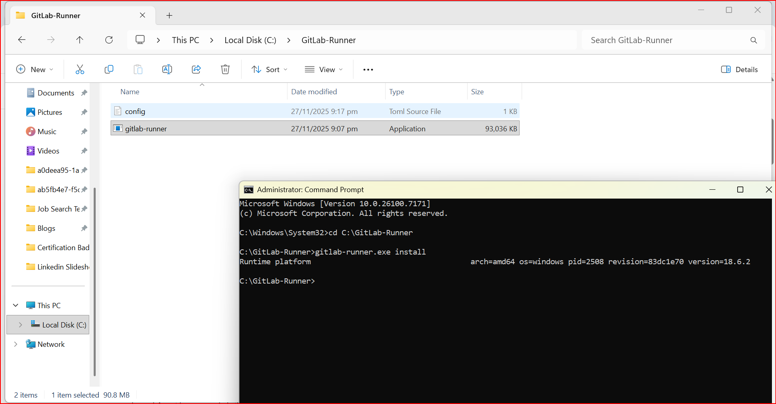
#NZBAS25
#NZBAS25
#NZBAS25
Compliance
Complete audit trail

Slide 20
Future Enhancements
Automated testing frameworks integration
AI-powered deployment insights
Multi-region deployment strategies
Advanced monitoring and analytics
#NZBAS25

Slide 21
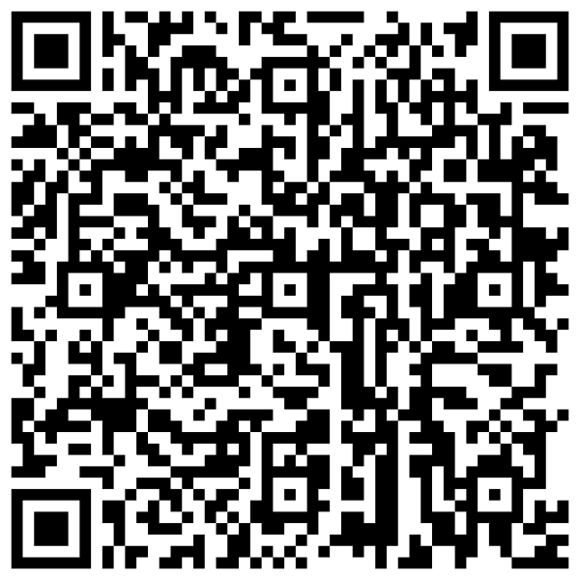
Resources
Blog Post
PAC CLI Documentation: aka.ms/pac-cli
Power Platform ALM Guide
GitLab CI/CD Documentation
Google Cloud Build Samples
#NZBAS25

Slide 22
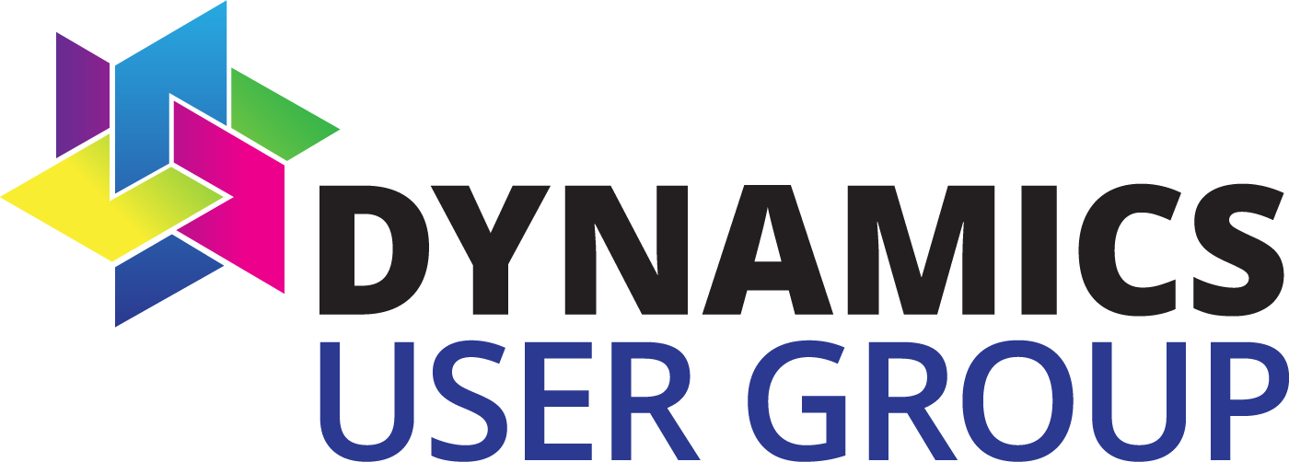
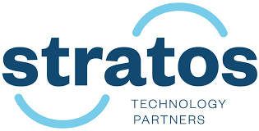
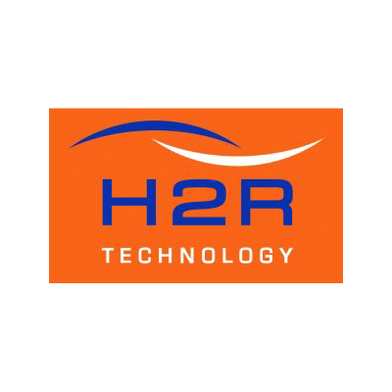
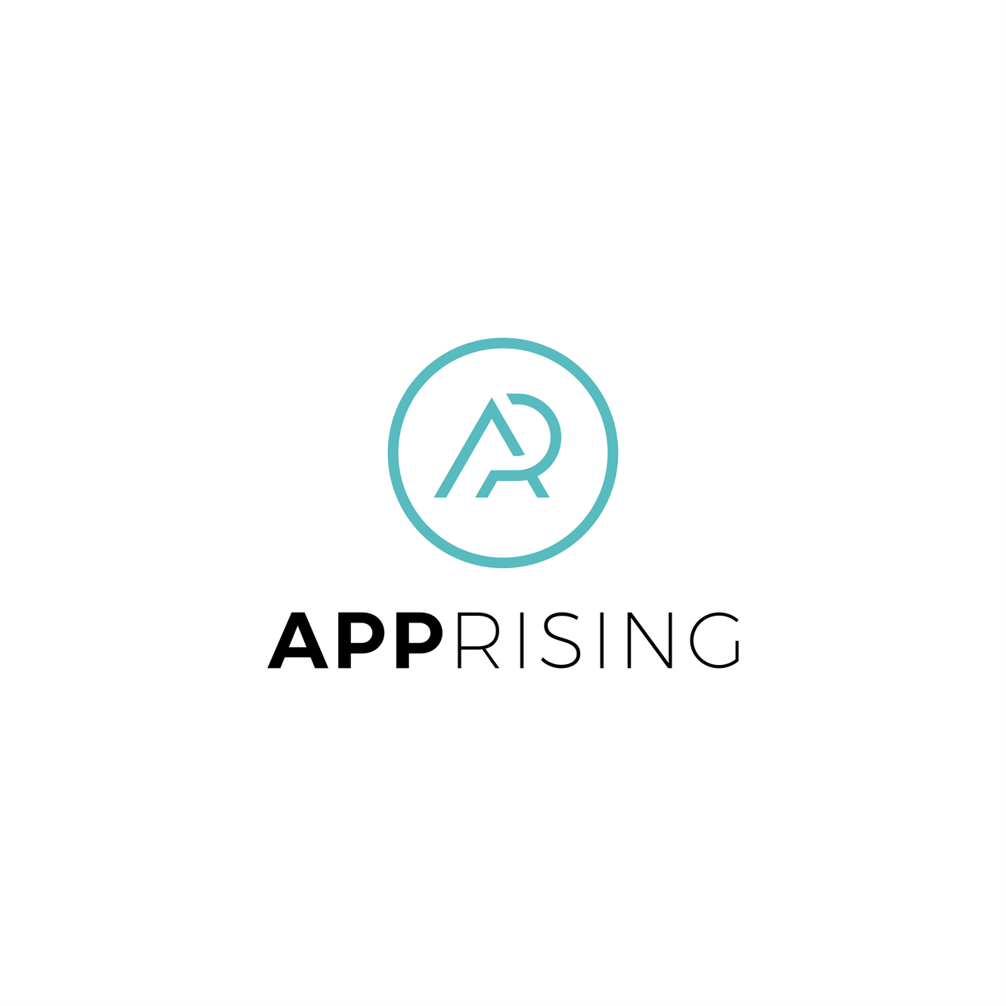
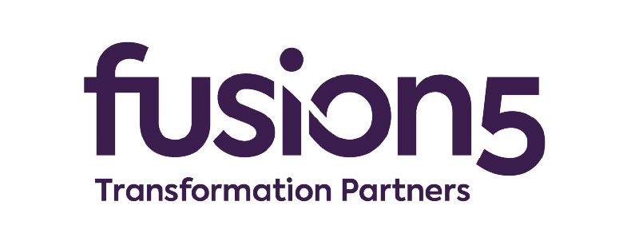
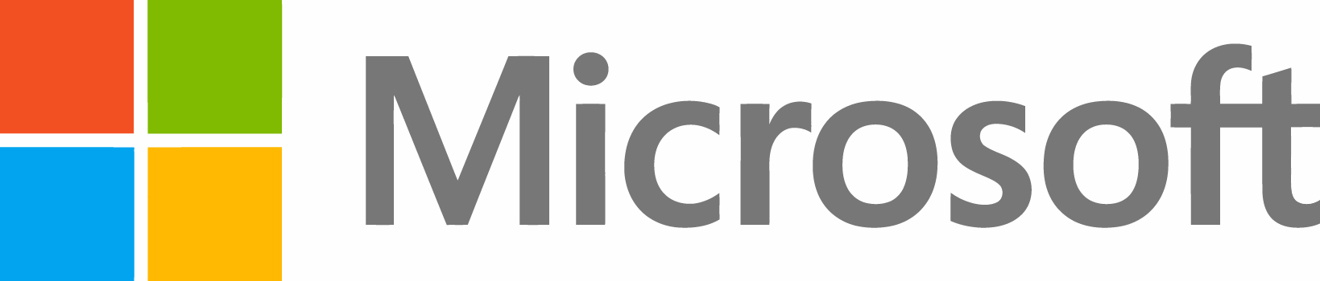
Thank you

